Slide 1

Notes:
Good morning, everyone, and welcome. Today, we’re diving into a core structural reality defining current financial markets: The Narrative Premium: Pricing Stories vs. Fundamentals in a High-Beta Market.
Historically, traditional valuation models—discounted cash flow (DCF) analysis, price-to-earnings multiples, and strict revenue yields—were the golden standard for asset pricing. But in the current macro environment, we are observing a profound shift. Capital flows are no longer dictated purely by present cash flows; instead, they are driven by the scale, narrative velocity, and perceived Total Addressable Market (TAM) of a project.
Over the next 45 to 60 minutes, we are going to break down how global debasement concerns are forcing investors up the risk curve, why private venture capital is pricing early-stage startups like high-upside call options, and how protocols like Hyperliquid, Pump.fun, and Ethena demonstrate the dynamic spectrum of narrative valuation. Let’s dive in.
https://www.youtube.com/watch?v=sGiv1Ws5dwc

Slide 2
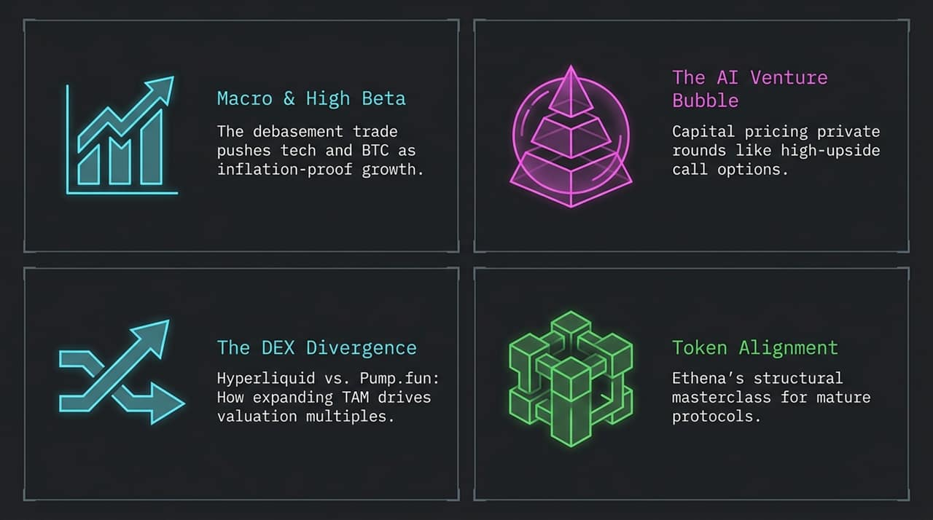
Notes:
To give you a roadmap of our session today, we have broken this analysis into four core themes:
Macro & High Beta: We’ll explore how currency debasement and macro liquidity dynamics have killed traditional uncorrelated hedging strategies, turning crypto and high-beta tech into primary growth hedges.
The AI Venture Bubble: We will examine VC behaviors, specifically looking at insane pre-revenue valuations like Instinct AI, and how investors are playing for 'king-making' option value.
The DEX Divergence: We will conduct a head-to-head comparison of Hyperliquid and Pump.fun—two protocols generating massive revenue, yet trading at radically different valuation multiples due to narrative framing.
Token Alignment & Governance: Finally, we’ll dive into Ethena’s recent tokenomics reset—a case study on how mature protocols must clean cap tables, eliminate VC overhangs, and align IP to survive.

Slide 3
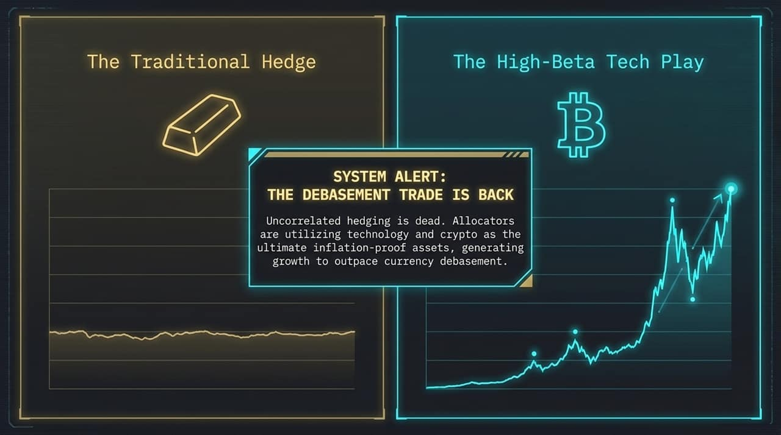
Notes:
Let's start with the macro picture. As highlighted in recent market roundups, uncorrelated hedging is largely dead. For years, institutional allocators sought uncorrelated assets to hedge inflation or geopolitical distress. But today, with US government debt running rampant and roughly 20% of the federal budget dedicated solely to servicing interest on that debt, sovereign currency debasement is an accepted baseline expectation.
When central banks pump liquidity and fiscal deficits widen, gold acts as a traditional store of value. However, allocators seeking to outpace currency degradation cannot rely on low-yielding traditional hedges. Instead, capital is flooding into technology and crypto as the ultimate high-beta, inflation-proof growth assets. The market is treating Bitcoin and frontier tech as growth instruments that outpace money supply expansion.

Slide 4
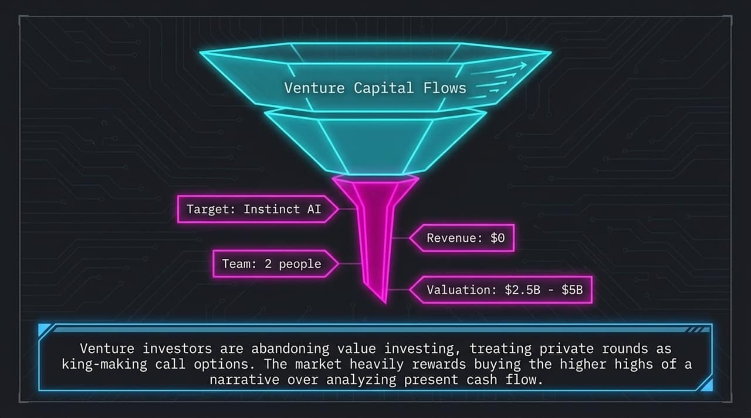
Notes:
This macro backdrop feeds directly into private market valuations, leading us to what we call the AI Venture Bubble.
Consider the case of Instinct AI shown on the slide. Here is a company with $0 in revenue and a team of just 2 people, yet venture investors bid its valuation up from $2.5 Billion to $5.0 Billion in short succession.
Why? Venture capitalists have effectively abandoned traditional value investing and discounted cash flow models. In an era dominated by technological shifts, private rounds are treated like asymmetric, high-upside call options. VCs are willing to deploy massive check sizes to 'king-make' a player. Buying into the higher highs of a compelling, infinite narrative is currently far more rewarded than underwriting present cash flows.

Slide 5
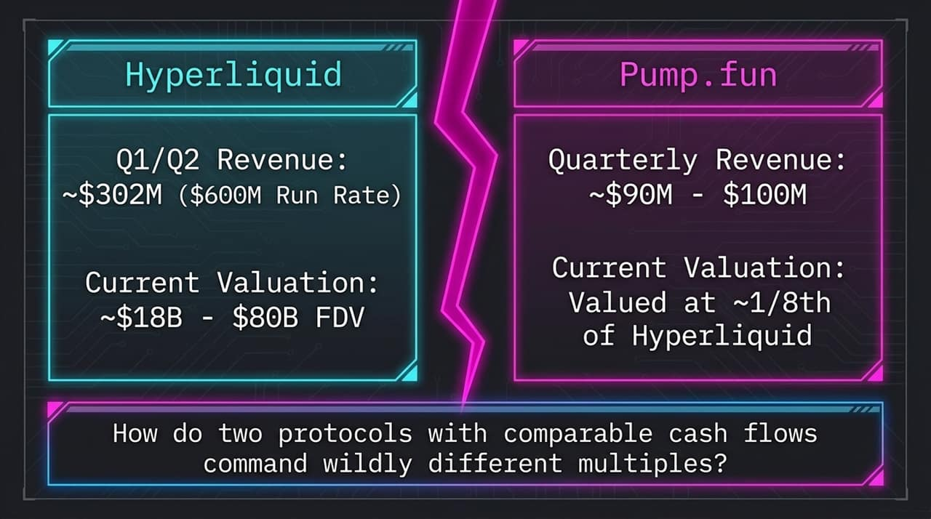
Notes:
Now, let's look at how this narrative pricing manifests within crypto protocol valuations, specifically comparing two revenue-generating titans: Hyperliquid and Pump.fun.
On paper, both protocols are absolute cash cows.
Hyperliquid generated ~$302 million across Q1 and Q2, pacing at an annualized revenue run rate of approximately $600 million. It commands a Fully Diluted Valuation (FDV) ranging between $18 billion and $80 billion depending on market swings.
Pump.fun generates $90M to $100M per quarter—a massive business by any standard. Yet, Pump.fun trades at roughly 1/8th the valuation of Hyperliquid.
How do two protocols generating comparable high-margin cash flows command wildly different valuation multiples? That is the central question of the Narrative Premium.

Slide 6
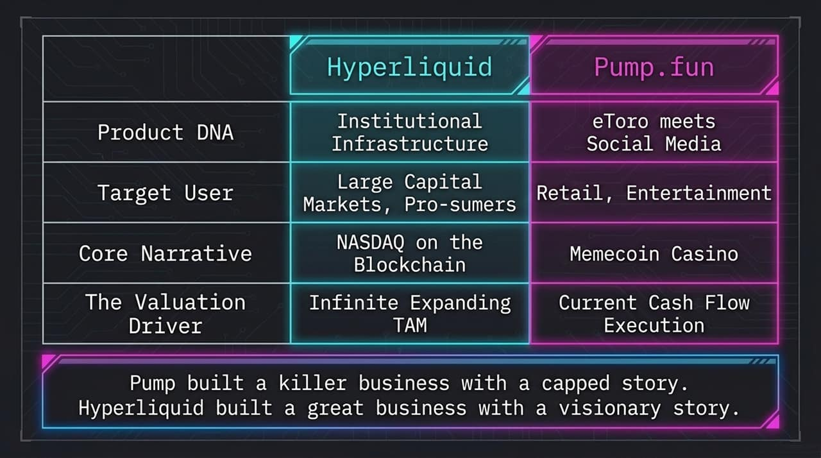
Notes:
To understand the valuation gap between Hyperliquid and Pump.fun, we must dissect their Product DNA.
Infrastructure vs. Application: Hyperliquid built institutional-grade exchange infrastructure—an ultra-performant L1 order book designed for prosumers and institutional capital. Pump.fun built a retail-facing consumer app—effectively 'eToro meets social media'—tailored for retail speculation.
Core Narrative: Hyperliquid positions itself as 'NASDAQ on the Blockchain'—a venue to eventually trade every global stock, bond, currency, and commodity on-chain. Pump.fun's narrative is bound to the 'Memecoin Casino'.
Valuation Driver: Pump.fun is valued strictly on its current cash flow and execution. Hyperliquid is valued on an infinitely expanding Total Addressable Market (TAM).
Pump built a killer business with a capped story. Hyperliquid built a great business paired with a visionary story.

Slide 7
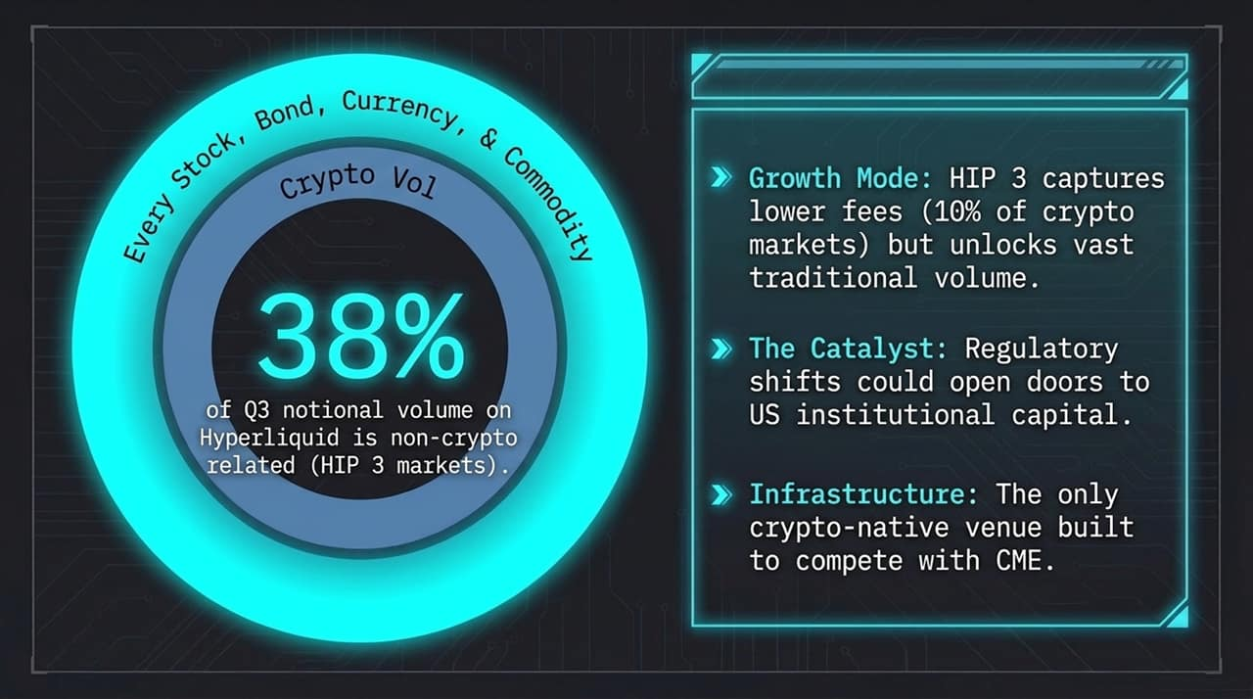
Notes:
Why is the market so convinced of Hyperliquid’s expanding TAM? The proof lies in their market expansion metrics.
Look at the HIP-3 governance proposal and asset statistics. 38% of Q3 notional volume on Hyperliquid is now non-crypto related. They are actively capturing traditional asset volume—commodities, foreign exchange, equities indices—on-chain.
Even though HIP-3 markets capture lower fee tiers (roughly 10% of standard crypto taker fees to remain competitive with TradFi venues like CME), this strategy unlocks vast traditional financial volume. Add to this the potential catalyst of regulatory shifts bringing compliant US institutional capital into Hyperliquid, and you have an exchange venue engineered to compete directly with legacy giants.

Slide 8
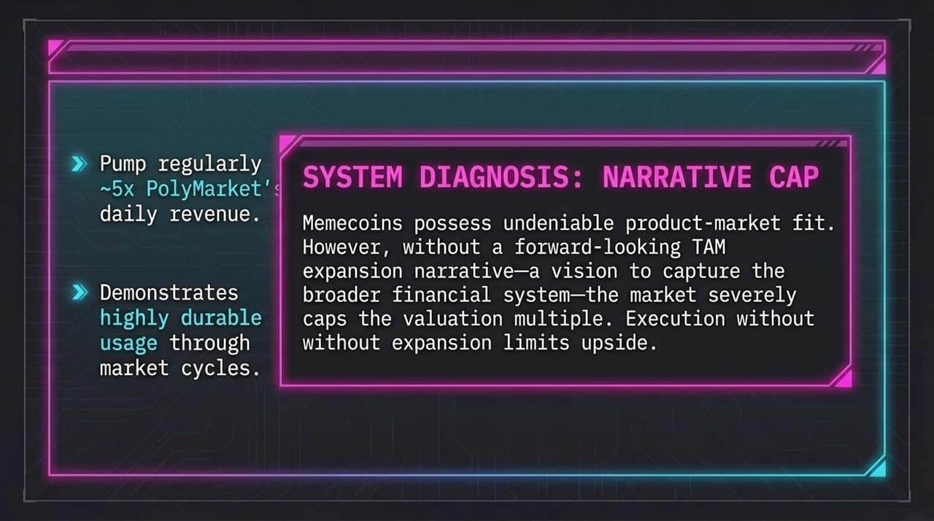
Notes:
Conversely, let's diagnose why Pump.fun faces a 'Narrative Cap'.
Pump.fun has undeniable, extraordinary Product-Market Fit. It regularly generates nearly 5x the daily revenue of platforms like PolyMarket and demonstrates durable usage through volatile market cycles.
However, without a forward-looking TAM expansion narrative—a articulate vision to capture broader traditional finance—the market severely caps its valuation multiple.
As illustrated on the matrix:
Pump.fun: High Revenue, Low Narrative → Low Multiple
Hyperliquid: High Revenue, High Narrative → High Multiple
Instinct AI: $0 Revenue, Infinite Narrative → Extreme Multiple
Execution without narrative expansion hard-caps your upside.

Slide 9
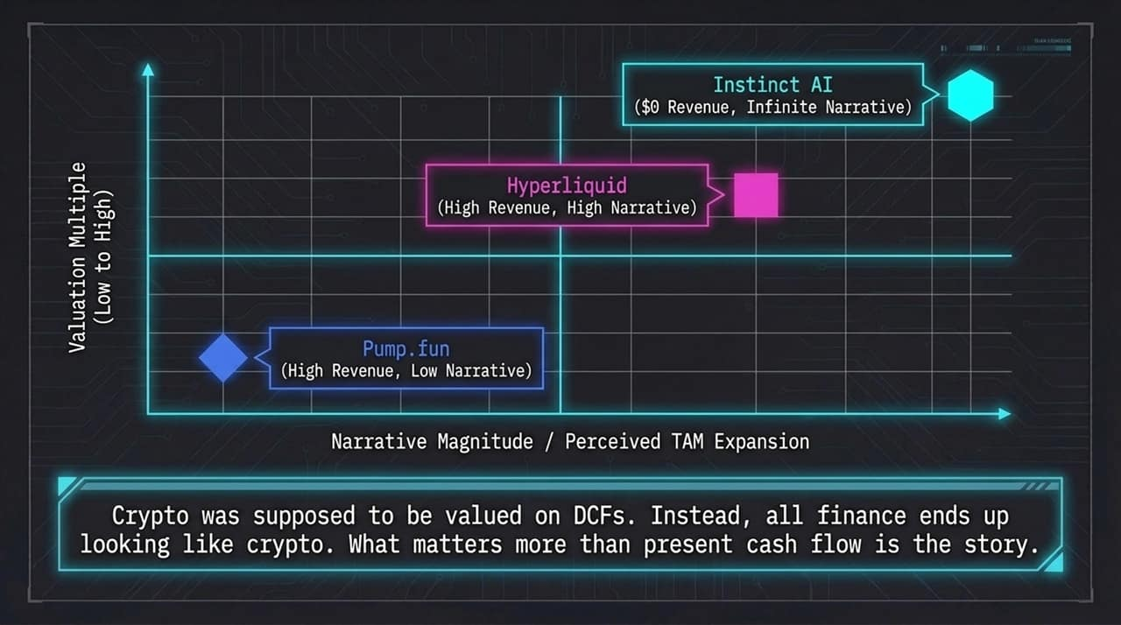
Notes:
What happens when a protocol matures and needs to convert its narrative into lasting institutional structure? This brings us to Ethena (ENA).
The industry has long suffered from the 'Low Float / High FDV' token overhang—where massive monthly unlocks from early VCs dump on secondary markets, suppressing token price regardless of revenue growth.
The Ethena Foundation recently executed a four-step tokenomics reset:
Buyout of Early Sellers: The Foundation bought out locked tokens from seed investors who sold over the last 9 months.
IP & Value Alignment: Transferred all IP and protocol value from Ethena Labs (the equity entity) to the Foundation (the token holders.
Programmatic Buybacks: Implemented a fee-switch directing net protocol revenues into buying ENA.
Removal of VC Overhang: Unlocked all unvested investor tokens immediately to force true price discovery.

Slide 10
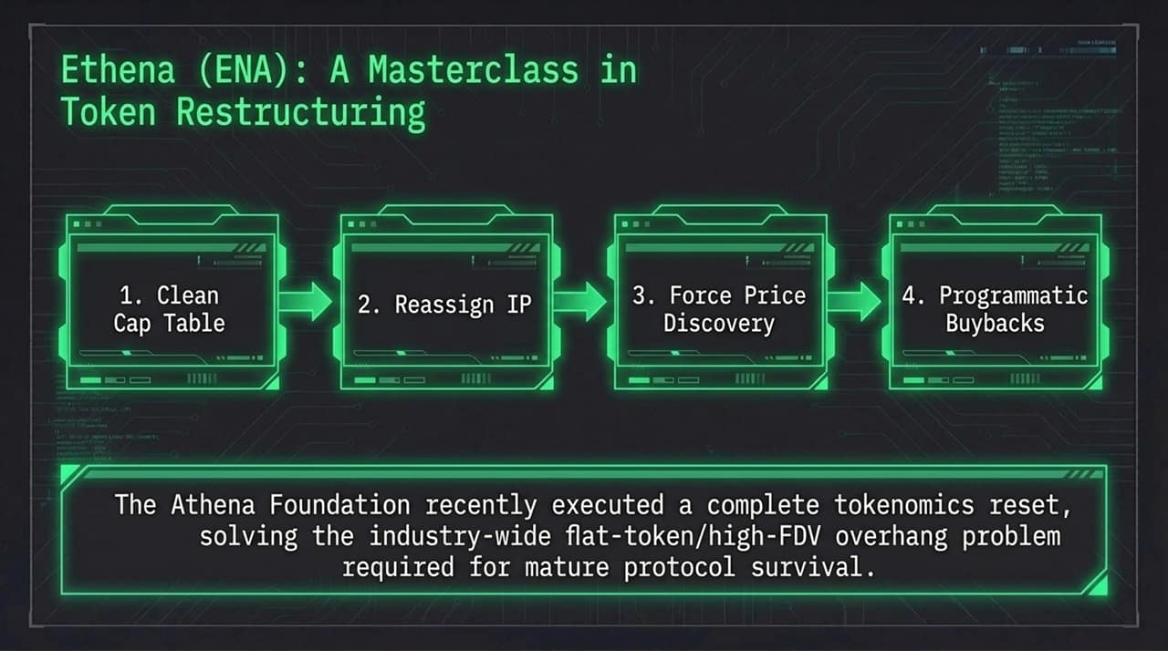
Notes:
Let's break down the mechanics of Move 1 and Move 2.
Move 1: The Buyout
Action: The Foundation stepped in to buy out seed investors who were active sellers on secondary markets over the past 9 months.
Impact: This immediately removed toxic overhang and misaligned capital partners who were bleeding the token's market cap.
Move 2: IP Alignment
Action: A master framework agreement formally reassigned all intellectual property, revenue rights, and protocol value from the development company (Ethena Labs) to the token foundation.
Impact: This eliminated cash flow leakage to equity holders. The core principle was established: The token IS the business.

Slide 11
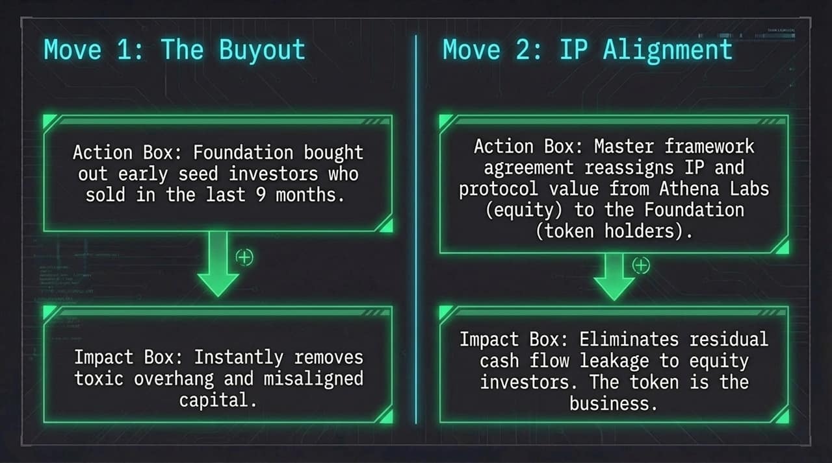
Notes:
Next, let's examine the structural adjustments made to Ethena's supply and cash flow dynamics.
The Fee Switch & Revenue Accrual: Ethena activated programmatic buybacks where 100% of net revenue generated across all Ethena product lines is used directly on the open market to buy back ENA tokens.
Removing Monthly Unlocks (Circulating Supply Reset): Instead of subjecting the token to recurring monthly VC unlocks that suppress buyer confidence, Ethena released all unvested VC tokens immediately. Fully unlocking the investor supply removes lingering fear of hidden unlocks and forces immediate, transparent price discovery in the open market.

Slide 12
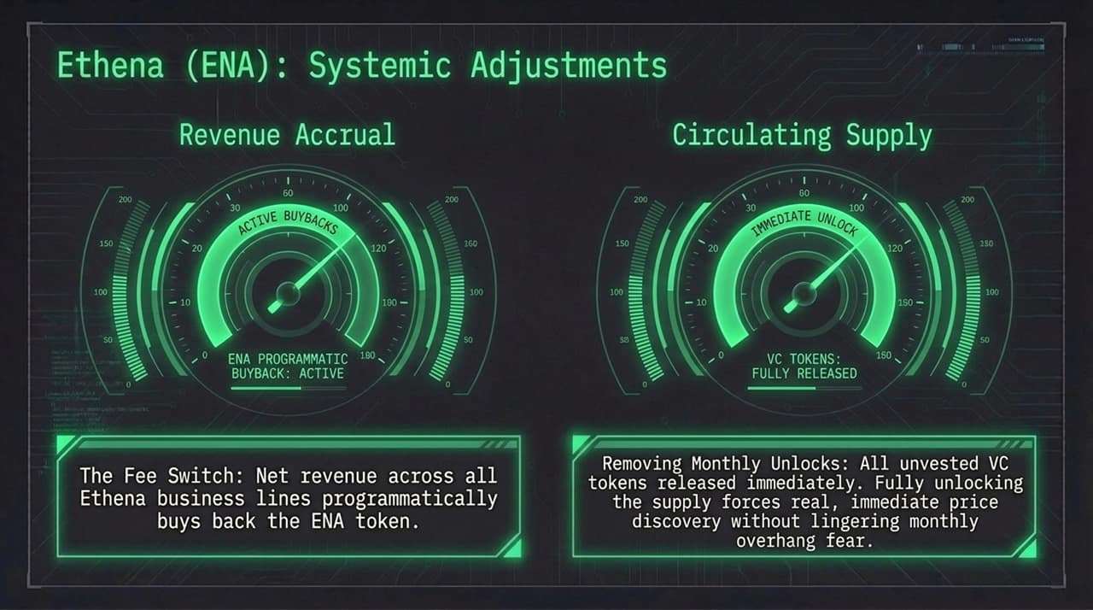
Notes:
Why is Ethena executing these structural resets now? Because it is positioning itself as the foundational yield infrastructure for all on-chain finance.
Ethena is moving far beyond simple delta-neutral basis trades. As shown in the diagram:
FalconX: Integrating $1B in secured lending.
BlackRock: Integrating real-world TradFi asset yields.
Janus Henderson: Incorporating CLLO (Collateralized Loan Obligation) products for enhanced risk-adjusted yields.
Distribution Partners: Direct vault integrations into consumer gateways like Coinbase and Robinhood.
Ethena is constructing a 'Money Market Fund Plus' collateral asset to power decentralized exchanges and money markets globally.

Slide 13
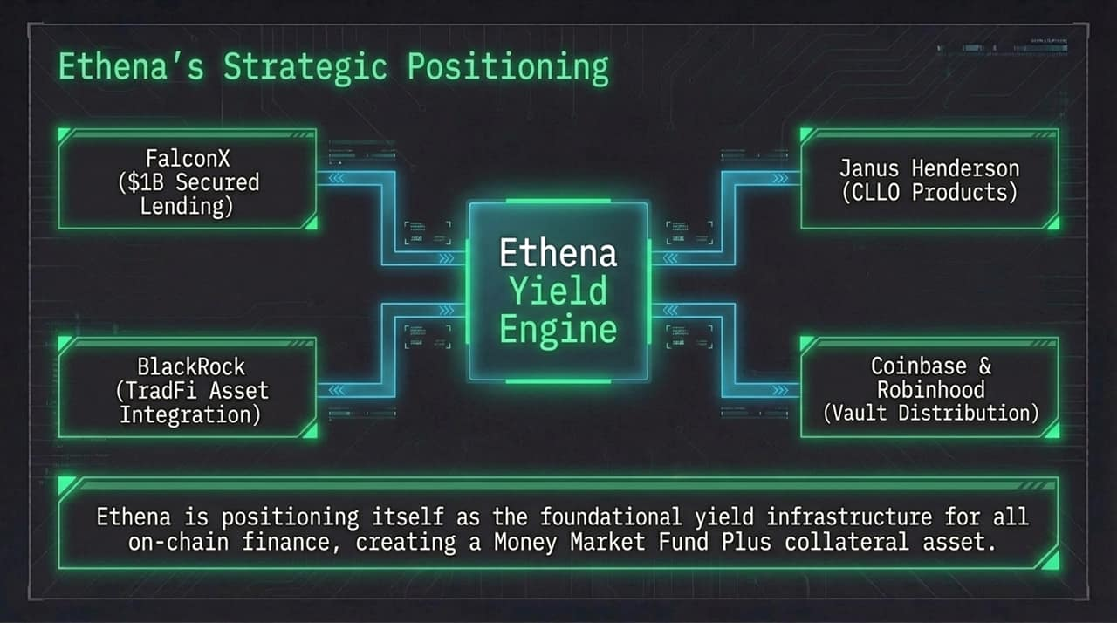
Notes:
As we look beyond pure infrastructure, the next major frontier in high-beta markets is the convergence of Consumer Social and Financial Trading.
Apps like FOMO are succeeding where earlier iterations (like Vector) struggled. Key drivers include:
Non-crypto native UX: Eliminating complex wallet setups and gas fees in favor of sleek, intuitive social interfaces.
Aggressive, Data-Driven Customer Acquisition: Reaching users directly on TikTok and Instagram rather than relying solely on Crypto Twitter.
The intersection of viral social engagement and instant financial speculation represents the breakout consumer application layer of this cycle.

Slide 14
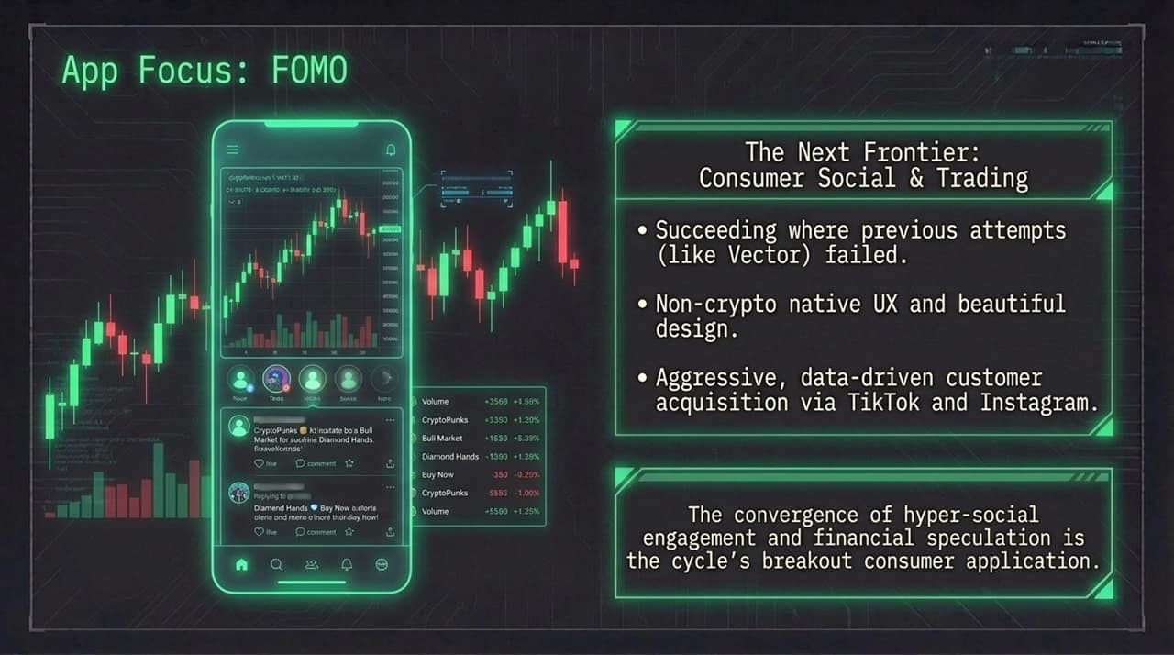
Notes:
To summarize our strategic framework today, we outline three core rules of The Market Blueprint:
The Convergence of Liquidity: The boundary between public equities and private venture capital is disappearing. Capital across both spheres prices growth assets like upside options.
The Narrative Multiplier: Cash flow without a forward-looking story leads to multiple compression (e.g., Pump.fun). An expanding, infinite TAM is heavily rewarded by the market (e.g., Hyperliquid).
The Alignment Imperative: As narrative projects mature, long-term institutional capital demands clean cap tables, fee-switch value accrual, and absolute supply transparency (e.g., Ethena).

Slide 15
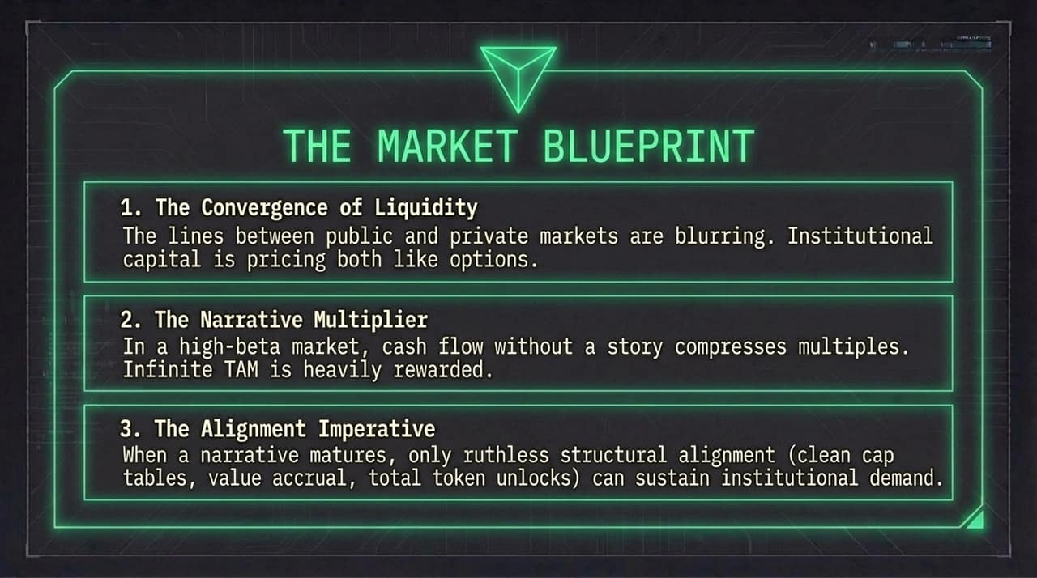
Notes:
Let's review the hard numbers side-by-side:
Hyperliquid: Generates ~$150M quarterly revenue ($600M run rate) with under 20 employees. Core vision: NASDAQ on the Blockchain for all financial assets. Commands the highest valuation multiple.
Pump.fun: Generates ~$90M–$100M quarterly revenue. Core vision: Hyper-social memecoin trading. Trades at a significantly lower multiple due to narrative constraints.
Ethena: Generates ~$56M quarterly revenue. Core vision: Stablecoin yield infrastructure and money-market collateral.
Notice that Pump produces nearly 2x Ethena’s quarterly revenue, yet trades at a similar valuation because Ethena captures an infrastructure TAM narrative.

Slide 16
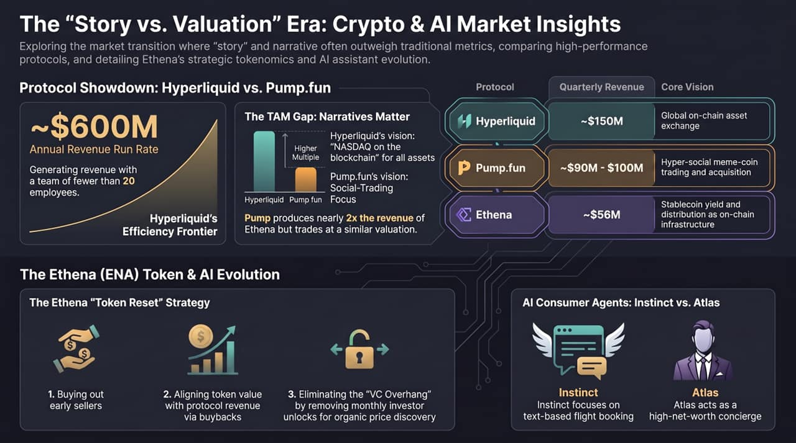
Notes:
Finally, let's touch upon the consumer application of AI agents—highlighting Instinct vs. Atlas:
Instinct: Focuses on seamless, text-based workflow automation—such as managing travel logistics, flight rebookings, and automated refunds. It highlights rapid product adoption, driving high VC valuations.
Atlas: Positioned as a high-net-worth concierge integrated with premium credit card infrastructure—capable of performing complex voice tasks, like calling service providers directly.
Both applications illustrate how narrative positioning—whether targeting mass text-based workflows or high-net-worth concierge services—dictates early market hype and capital inflows.
Thank you for your time, and I welcome any questions from the floor.

